Slide 1
Capstone Project: Designing RushMore Pizzeria's Enterprise Database System Reference Case Study: RushMore Pizza Delivery with Python Presented by Usani Eteng

Slide 2
Overview
Following the early success of its Python-based ordering tool, RushMore Pizzeria has expanded to multiple locations with a larger customer base and a more complex menu. However, the original JSON file system has become a major bottleneck—slow, difficult to query, vulnerable to data corruption, and unable to support multiple cashiers simultaneously. Management has rehired you as a Data Engineer and Database Administrator to design a scalable, cloud-based Relational Database Management System (RDBMS). Before migrating real customer data, you must build a proof-of-concept and populate it with over 10,000 rows of realistic, high-quality fake data to test performance, validate data types, and demonstrate analytics capabilities.

Slide 3
Objectives
The objective is to design, deploy, and populate a production-ready PostgreSQL database in the cloud. I will model RushMore Pizzeria’s operations by creating a normalized, scalable relational schema, then deploy and configure a Database as a Service (DBaaS) on Azure or Google Cloud Platform. Using Python, i will connect to the remote database, generate realistic synthetic data with Faker, and insert it in the correct relational order. The project evaluates your skills in data modeling, cloud deployment, and database programming. Optionally, you may connect an analytics tool to the database to generate insights and answer key business questions.

Slide 4
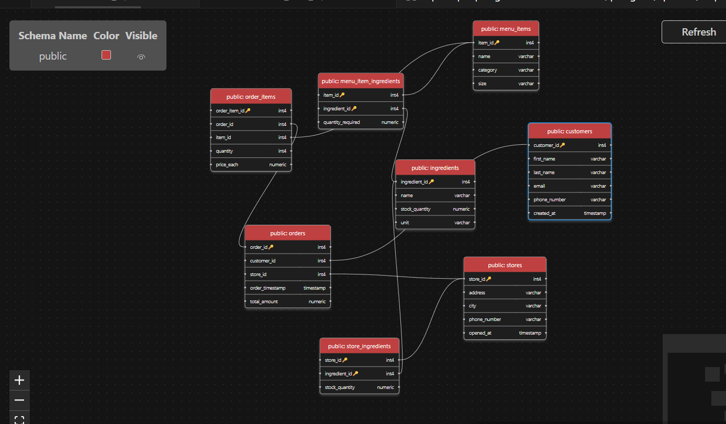
PART 1 — Database Modelling (Design)

Slide 5
SQL SCHEMA (CREATE TABLES)
CREATE TABLE Stores (
store_id SERIAL PRIMARY KEY,
address VARCHAR(255) NOT NULL,
city VARCHAR(100) NOT NULL,
phone_number VARCHAR(20) UNIQUE NOT NULL,
opened_at TIMESTAMP DEFAULT CURRENT_TIMESTAMP
);
CREATE TABLE Customers (
customer_id SERIAL PRIMARY KEY,
first_name VARCHAR(100) NOT NULL,
last_name VARCHAR(100) NOT NULL,
email VARCHAR(255) UNIQUE NOT NULL,
phone_number VARCHAR(20) UNIQUE NOT NULL,
created_at TIMESTAMP DEFAULT CURRENT_TIMESTAMP
);
A few sql scheme will be represented here for the purpose of this presentation as the table was normalized to 3N

Slide 6
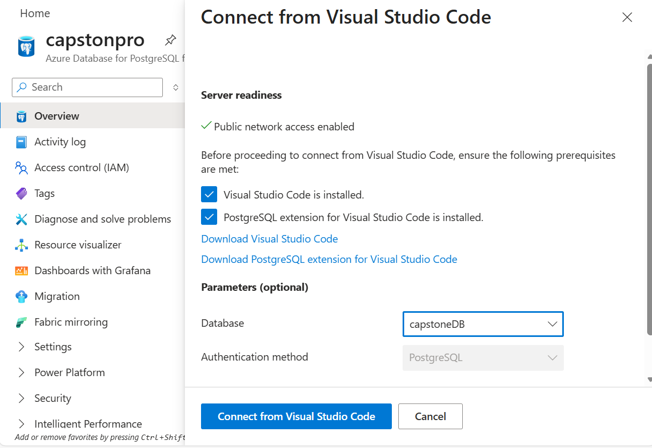

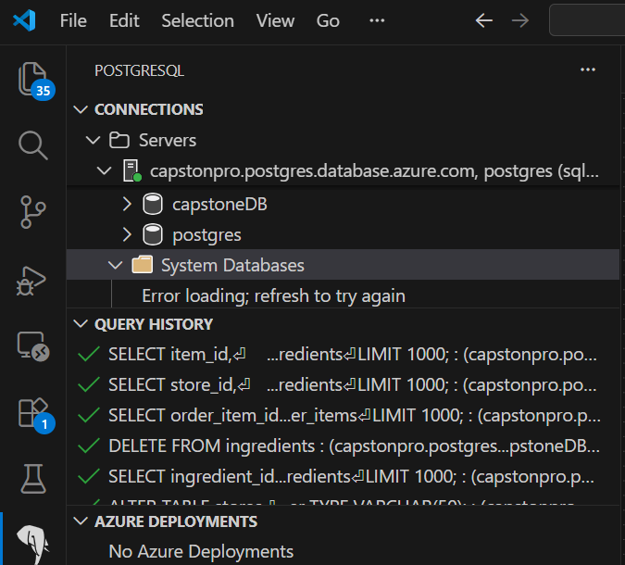
PART 2 — Cloud Deployment (Azure or GCP)ng strategies I choose azure since it was widely used in my location. And the Step 3: Connect using pgAdmin

Slide 9
Thank You
USANI ETENG
DATA ENG.

